Slide 1


Project Bicep: ARM Templates Evolved
Sam Cogan
Solution Architect, Willis Towers Watson & Microsoft MVP

Slide 2





About Me
Sam Cogan
Solution Architect – Willis Towers Watson
Microsoft Azure MVP
samcogan.com
@samcogan
sam-cogan

Slide 3
ARM Templates
{
"name": "storageaccount1",
"type": "Microsoft.Storage/storageAccounts",
"apiVersion": "2019-06-01",
"tags": {
"displayName": "storageaccount1"
},
"location": "[resourceGroup().location]",
"kind": "StorageV2",
"sku": {
"name": "Premium_LRS",
"tier": "Premium"
}
}
Notes:
FunctionExamples.json – UniqueString, ResourceGroup, ListKeys, toLower
SaSToken.json – generating a SAS token with ListKeys
Mod.json – using mod to alternate between storage accounts

Slide 4
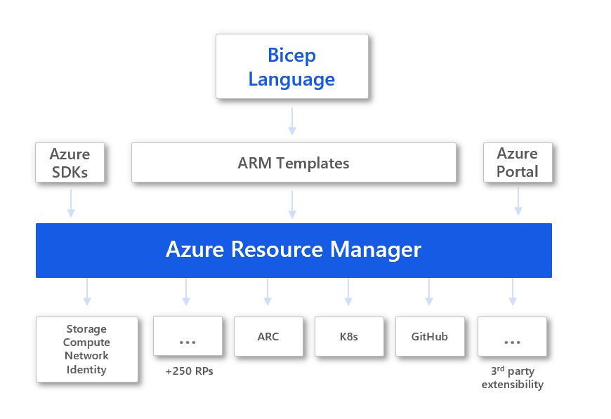
Bicep
Notes:
FunctionExamples.json – UniqueString, ResourceGroup, ListKeys, toLower
SaSToken.json – generating a SAS token with ListKeys
Mod.json – using mod to alternate between storage accounts

Slide 5
Bicep
resource storageaccount1 'Microsoft.Storage/storageAccounts@2019-06-01' ={
name: 'storageaccount1'
kind: 'StorageV2'
location: resourceGroup().location
sku: {
name: 'Standard_LRS'
tier: 'Standard'
}
}
Notes:
FunctionExamples.json – UniqueString, ResourceGroup, ListKeys, toLower
SaSToken.json – generating a SAS token with ListKeys
Mod.json – using mod to alternate between storage accounts

Slide 6

Bicep is currently in preview
It is not ready for production!
There are features in ARM templates that are not yet ready in Bicep:
Copy Loops
Condition Property
Single line Objects and Arrays
Support
Notes:
FunctionExamples.json – UniqueString, ResourceGroup, ListKeys, toLower
SaSToken.json – generating a SAS token with ListKeys
Mod.json – using mod to alternate between storage accounts

Slide 7
Benefits of Bicep
Simpler Syntax
Simple string interpolation – goodbye concat!
Simple resource declaration
Direct property access
Modularisation
Declare parameters, variables, types anywhere
Automatic dependency management (in some scenarios)
Improved validation and Intellisense
Notes:
FunctionExamples.json – UniqueString, ResourceGroup, ListKeys, toLower
SaSToken.json – generating a SAS token with ListKeys
Mod.json – using mod to alternate between storage accounts

Slide 8
Demo
Using Bicep

Slide 9
Custom Modules
module stgacct './storage_module.bicep' ={
name: 'storageaccount'
params: {
storageAccountName: '${prefix}stg'
}
}
Notes:
FunctionExamples.json – UniqueString, ResourceGroup, ListKeys, toLower
SaSToken.json – generating a SAS token with ListKeys
Mod.json – using mod to alternate between storage accounts

Slide 10
Demo
Modules

Slide 11

Migrating to Bicep
Manual conversion
Decompile an ARM Template
bicep decompile "path/to/file.json"
Decompile a Resource Group
az group export --name "your_resource_group_name" > main.json
bicep decompile main.json
Notes:
FunctionExamples.json – UniqueString, ResourceGroup, ListKeys, toLower
SaSToken.json – generating a SAS token with ListKeys
Mod.json – using mod to alternate between storage accounts

Slide 12

Why Use Bicep?
New users coming to IaC in Azure for the first time
Existing ARM users wanting a simpler language
Existing ARM users wanting new language features
Access to the latest Azure resources fastest
Support from Microsoft
Notes:
FunctionExamples.json – UniqueString, ResourceGroup, ListKeys, toLower
SaSToken.json – generating a SAS token with ListKeys
Mod.json – using mod to alternate between storage accounts

Slide 13
IaC Tooling Comparison
 | ARM Templates | Bicep | Terraform | Pulumi
Languages | JSON | Custom DSL | Custom DSL (HCL) | Node JS (TS, JS), Python, .NET Core, GO
Complexity | High | Medium | High | High
Speed Of Update | Fast | Fast | Slower | Slower
Multi Cloud | No | No | Yes | Yes
Stateful | No | No | Yes | Yes
Open Source | No | Yes* | Yes | Yes
Support | Microsoft | Community (until 0.3) | Community/Paid | Community/Paid
Additional Features | Policy (separate service) | Policy (separate service) | Cloud State Policy & Governance Module Repository Web Portal Cost Estimation | Cloud State Policy & Governance Web Portal
Notes:
FunctionExamples.json – UniqueString, ResourceGroup, ListKeys, toLower
SaSToken.json – generating a SAS token with ListKeys
Mod.json – using mod to alternate between storage accounts

Slide 14

Useful Resources
Bicep GitHub Repository - https://cogan.to/rtj
Bicep Tutorial - https://cogan.to/c5t
Introduction to Bicep - https://cogan.to/x6t
These slides and demos - https://cogan.to/an9
Notes:
FunctionExamples.json – UniqueString, ResourceGroup, ListKeys, toLower
SaSToken.json – generating a SAS token with ListKeys
Mod.json – using mod to alternate between storage accounts

Slide 15
About Me
Sam Cogan
Solution Architect – Willis Towers Watson
Microsoft Azure MVP
samcogan.com
@samcogan
sam-cogan

